Slide 1
Does R&D Expenditure
Generate Alpha?
A Portfolio-Level Analysis
Jack Feen · Humphrey Hui · Michael Ovassapian
Empirical Finance – Project 1 | 1980–2022

Slide 2

Research Question & Methodology
Core Question: Do firms with higher R&D spending earn risk-adjusted excess returns?
Methodology
Sort firms annually into quintile portfolios by R&D expenditure level, creating two long-short portfolios
Construct equal-weighted and value-weighted portfolio returns using Fama-French convention
Test for alpha under CAPM (single-factor) and FF3F model
Analyze across two periods: 1980–2000 and 2001–2022
Empirical Finance – Project 1

Slide 3

Data Sources
Compustat (comp.funda)
CRSP (crsp.msf + crsp.msenames)
Annual R&D expenditure (xrd), 1979–2022
Filtered: USD, US-incorporated, major US exchanges, industrial format, financial companies and pharmaceuticals excluded via sich codes
Monthly stock returns & market equity, 1980–2022
Filtered: common shares (shrcd 10/11), NYSE/AMEX/NASDAQ (exchcd 1/2/3), non-financials
Fama–French Library (ff.factors_monthly)
CCM Link Table (crsp.ccmxpf_lnkhist)
Monthly Mkt-RF, SMB, HML, RF, 1980–2022
Primary links (LU/LC, P/C) bridging Compustat gvkeys to CRSP permnos
Empirical Finance – Project 1

Slide 4

Data Processing Pipeline
1
Negative R&D values set to NaN
Zero/missing R&D firms grouped into the same portfolio
2
CRSP returns cleaned: non-numeric coerced to NaN then all NaN dropped
Returns less than −100% excluded
3
Delisting returns merged via outer join as it preserves delisting-only observations
Effective return calculation to avoid survivorship bias: (1 + ret) × (1 + dlret) − 1
4
(xrd(t)+0.8xrd(t−1)+0.6xrd(t−2)+0.4xrd(t−3)+0.2xrd(t−4))/mkt(t)
xrd lag: Fama-French convention used i.e. take the year from datadate, add one, form portfolio in July
xrd is weighted by market cap to get r&d intensity
5
PERMCO aggregation: market equity summed across share classes
Largest PERMNO kept as representative
6
Market cap lagged by one month for value-weighting (avoids lookahead bias)
Empirical Finance – Project 1

Slide 5

Portfolio Formation
Sorting Variable: Annual weighted R&D expenditure (xrd) from Compustat
Groups: Missing/Null R&D portfolio, and Q1 to Q5 quintiles
Timing: Fama-French convention followed, so we formed portfolios in July
Rebalancing: Monthly
Weighting: Equal-weighted as simple average, value-weighted using prior-month market equity
Spread Portfolio: Q5 - Q1 (long high R&D, short low R&D) and Q5 - Q0 (long high R&D, short no R&D)
Empirical Finance – Project 1

Slide 6

Portfolio Summary Statistics
Firms per Year
R&D Intensity
R&D is zero or null: ~2,615 firms/year
Each quintile: ~365 firms
R&D is zero or null dominates
Q5: 0.88
  Mild rightward skew (median RD = 0.50)
Q1: 0.01
Market Cap
Monthly Returns
Q5 firms: $6B average, $35B standard deviation
Q1 firms: $0.5B average, $3.4B standard deviation
Little relation between size and R&D intensity
Q5: 2.24% mean return
Q1: 0.68% mean return
Not monotonic, Q4 and Q3 had means of 1.57% and 1.43%
Empirical Finance – Project 1

Slide 7
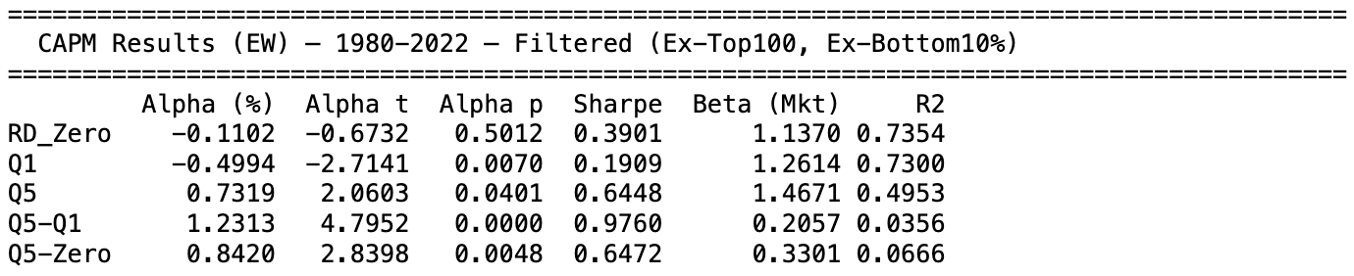
High/Low MKT Cap Excluded CAPM EW Results: 1980–2022
Empirical Finance – Project 1

Slide 8
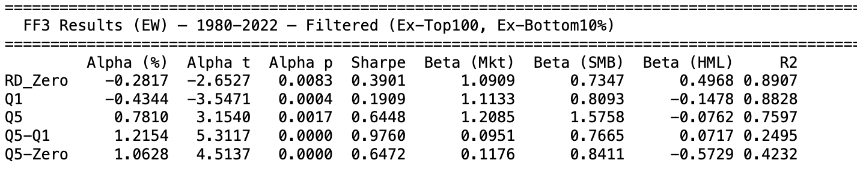
High/Low MKT Cap Excluded FF3F EW Results: 1980–2022
Empirical Finance – Project 1

Slide 9
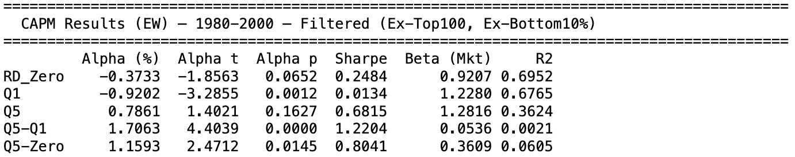
High/Low MKT Cap Excluded CAPM EW Results: 1980-2000
Empirical Finance – Project 1

Slide 10
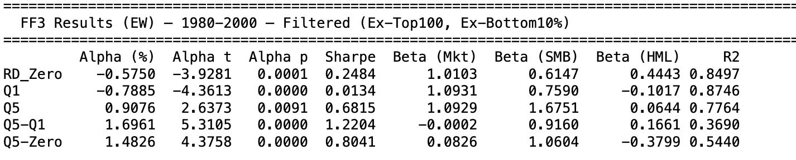
High/Low MKT Cap Excluded FF3F EW Results: 1980–2000
Empirical Finance – Project 1

Slide 11
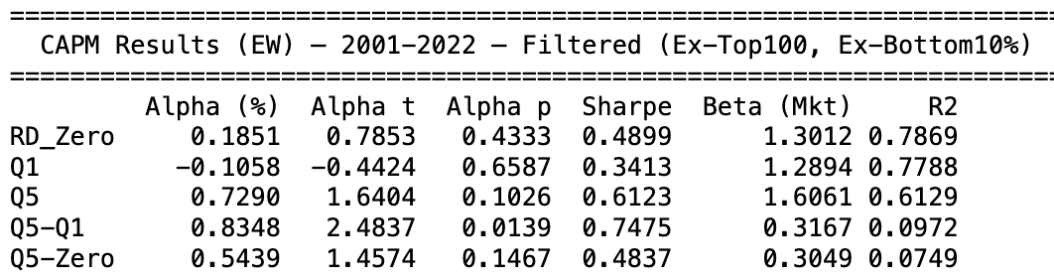
High/Low MKT Cap Excluded CAPM EW Results: 2001–2022
Empirical Finance – Project 1

Slide 12
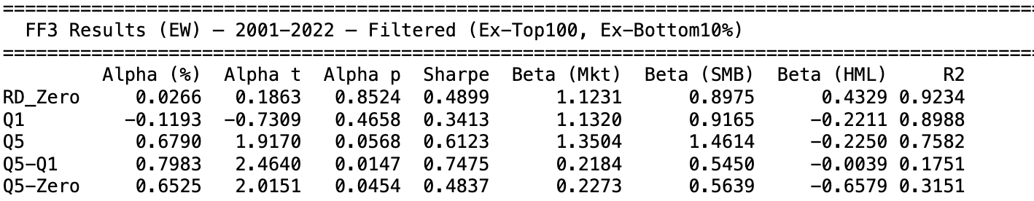
High/Low MKT Cap Excluded FF3F VW Results: 2001–2022
Empirical Finance – Project 1

Slide 13
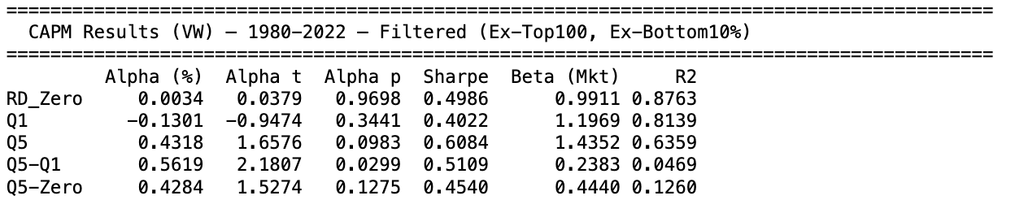
High/Low MKT Cap Excluded CAPM VW Results: 1980–2022
Empirical Finance – Project 1

Slide 14
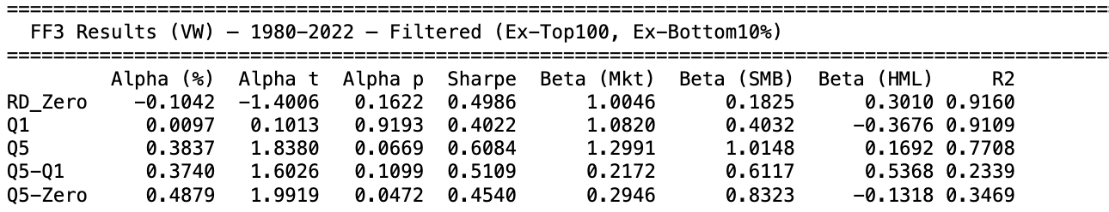
High/Low MKT Cap Excluded FF3F VW Results: 1980–2022
Empirical Finance – Project 1

Slide 15
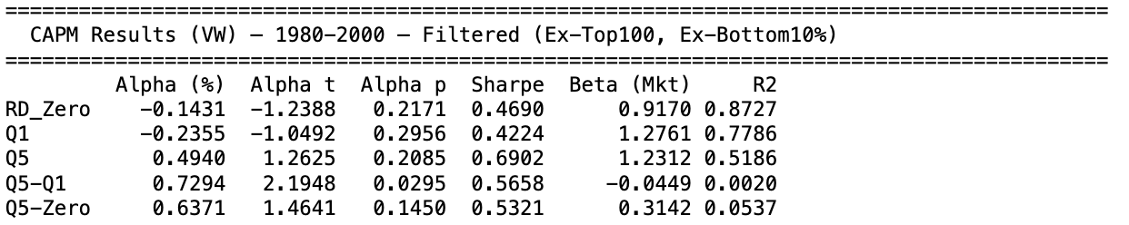
High/Low MKT Cap Excluded FF3F VW Results: 1980–2000
Empirical Finance – Project 1

Slide 16
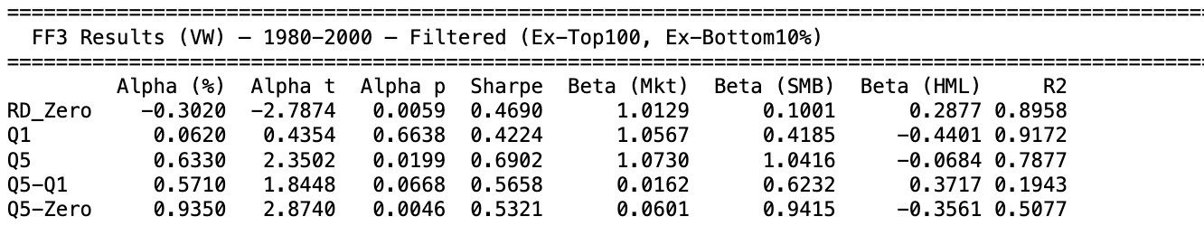
High/Low MKT Cap Excluded FF3F VW Results: 1980–2000
Empirical Finance – Project 1

Slide 17
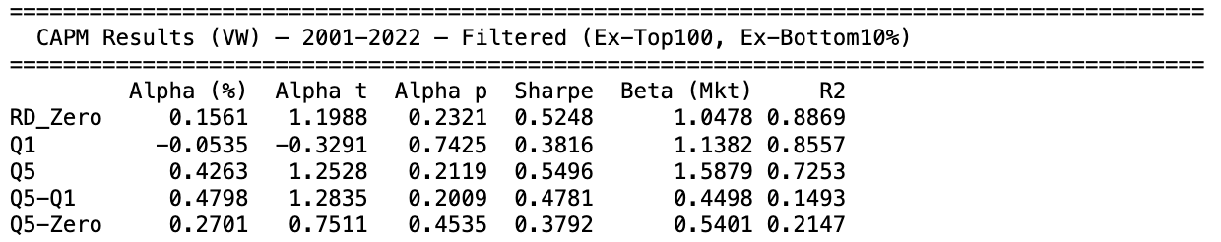
High/Low MKT Cap Excluded CAPM VW Results: 2001–2022
Empirical Finance – Project 1

Slide 18
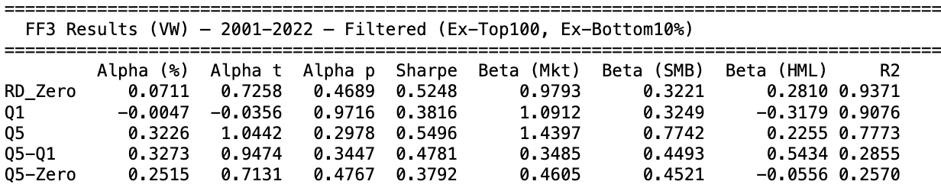
High/Low MKT Cap Excluded FF3F VW Results: 2001–2022
Empirical Finance – Project 1

Slide 19

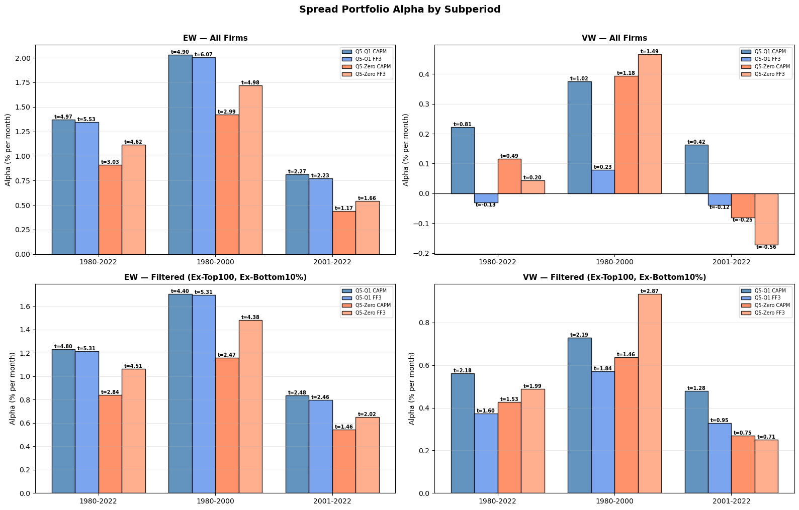
Long-Short Portfolio Alphas by Subperiod
Empirical Finance – Project 1

Slide 20
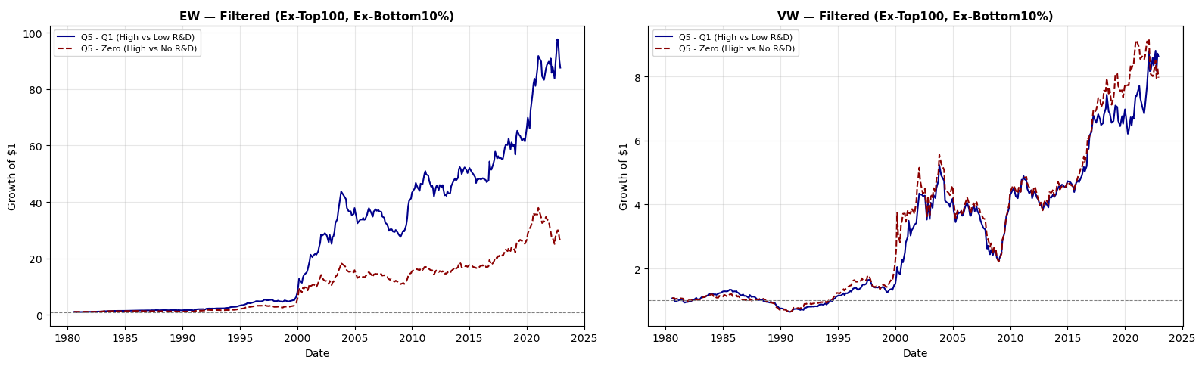
Cumulative Spread Returns
Empirical Finance – Project 1

